Slide 1


Website Manage Event Processes Yearly For Faculty OF IT
Phạm Vũ Quốc Cường – 517H0040
Trần Phạm Anh Tuấn – 517H0093
1

Slide 2

Introduction and Overview
Reason for choosing the topic:
Practicality:
Necessity: Event management of the IT department is currently facing many difficulties such as information not being updated promptly, and difficulty in tracking.
Effective solution: The event management website will help the IT department solve the above problems, bringing high efficiency in event management.
Process automation: The system will automate operations to save time and effort for the organizers.
Update information instantly: All information about the event will be quickly updated on the website, making it easy for participants to follow and tracking.
Monitor and evaluate effectiveness : The system provides detailed statistical reports about the status of events
Workability:
Ability of extension: The website can be expanded to manage many different types of events, from scientific conferences, symposiums to exchanges, workshops, ...
Fexibility: The system can be customized to fit the IT department's unique needs and event management process.
2

Slide 3
Introduction and Overview
Target in implementing the topic:
Build an effective event management website, meeting the needs of managing and organizing events of the IT department.
About functionality:
Provides full event management functions, including: creating events, registering to participate, tracking progress, sending notifications, sending reports, ...
Support future system expansion of the IT department.
About efficientcy:
Automate the event management process, helping to save time and effort for organizers.
Update information instantly and accurately, making it easy for participants to follow and grasp.
Improve event management efficiency, increase registration rates, and attract more attendees.
3

Slide 4
Presentation Content
01
03
05
Division of Work
Reference App
Advantages, Disadvantages
02
04
ERD Model
Project implementation
07
References
06
08
Orientation, Summary
Demo
4

Slide 5
01
Division of Work
5

Slide 6
Cuong’s Work
Backend
Build the system's ERD
Implement node-cron code to automatically notify
Implement the event handling code
Send notification emails.
Fontend
Home page calendar tab
Dashboard page summarizes information
Event management page
History tab user information page.
6

Slide 7
Tuan’s Work
Backend
Code login with google.
Import and export of excel files for students who register and participate.
User handling code (User).
Test project activities.
Fontend
Login page with google.
Home page Work process tab.
User management page.
Event management page.
User information Profile tab.
7

Slide 8
02
ERD Model
8

Slide 9
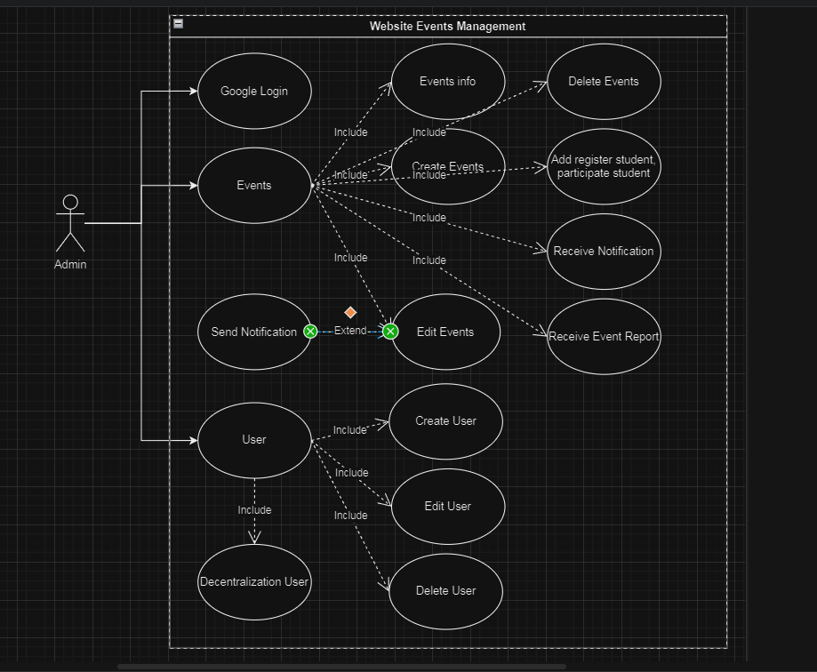
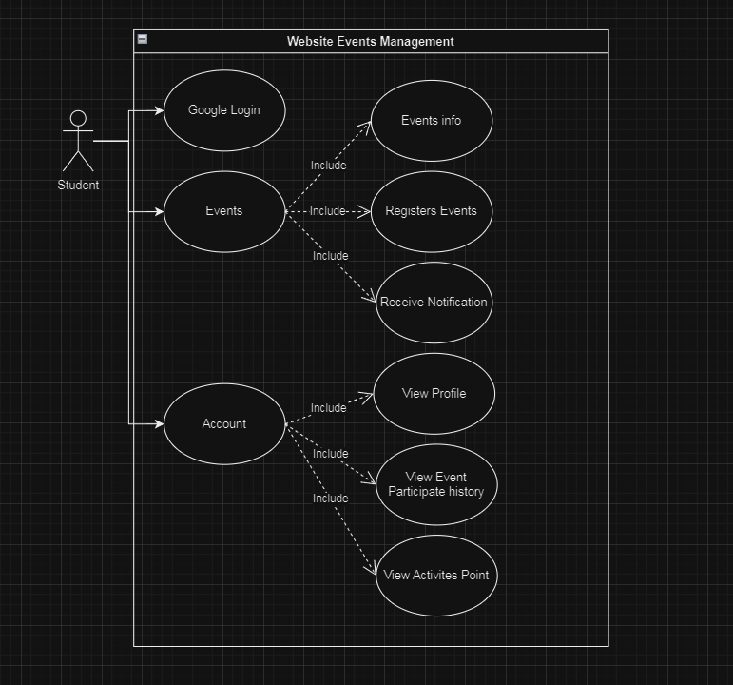
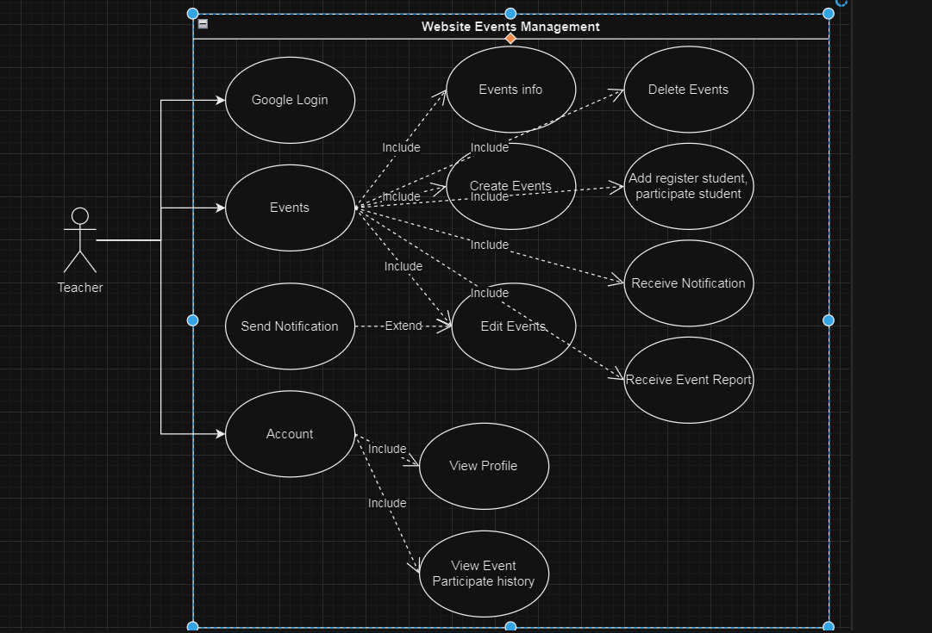
Student Usercase Diagram
Admin Usercase Diagram
Teacher Usercase Diagram
9

Slide 10
03
Reference App
10

Slide 11
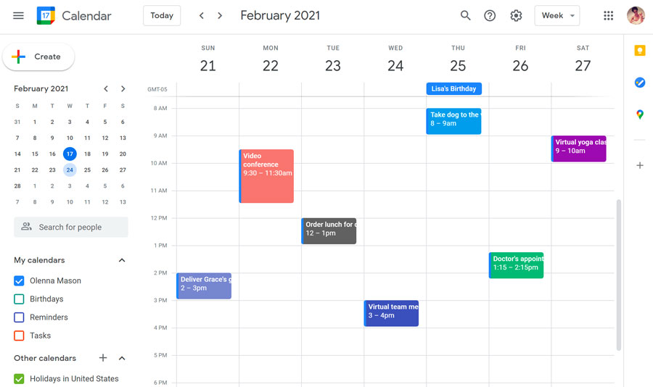
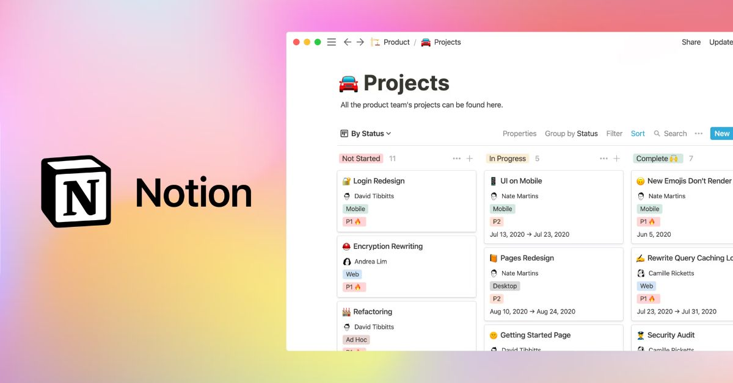
Google Calendar
Notion
11

Slide 12
04
Project Implementation
12

Slide 13
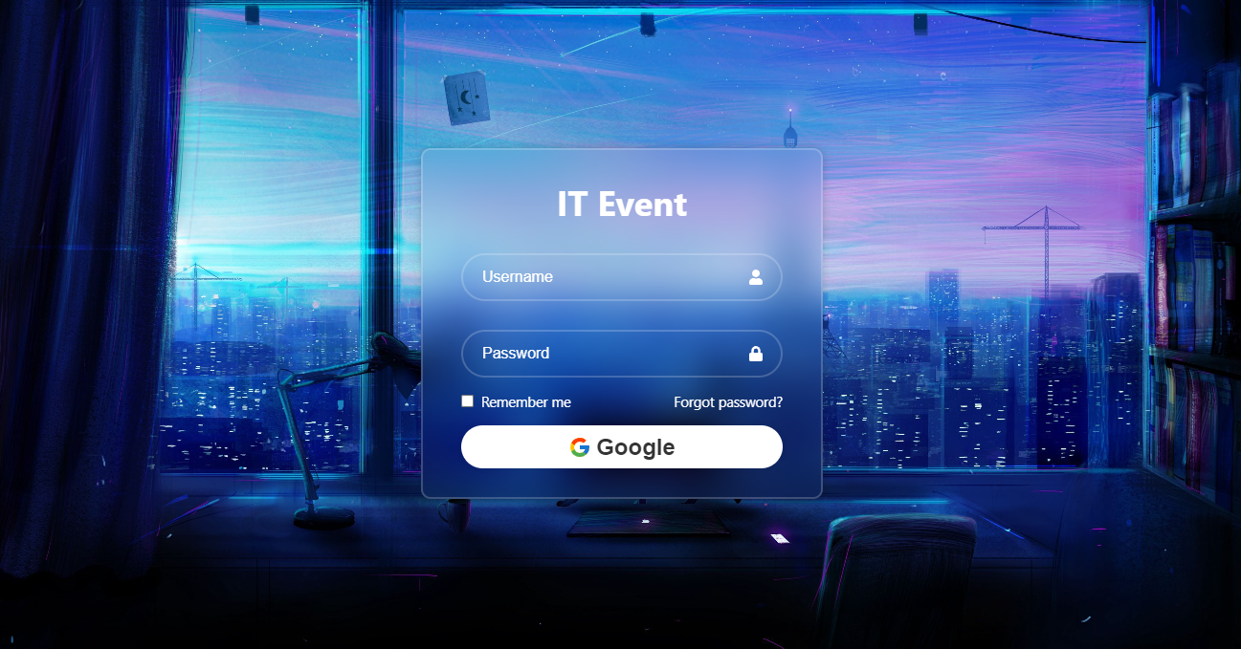
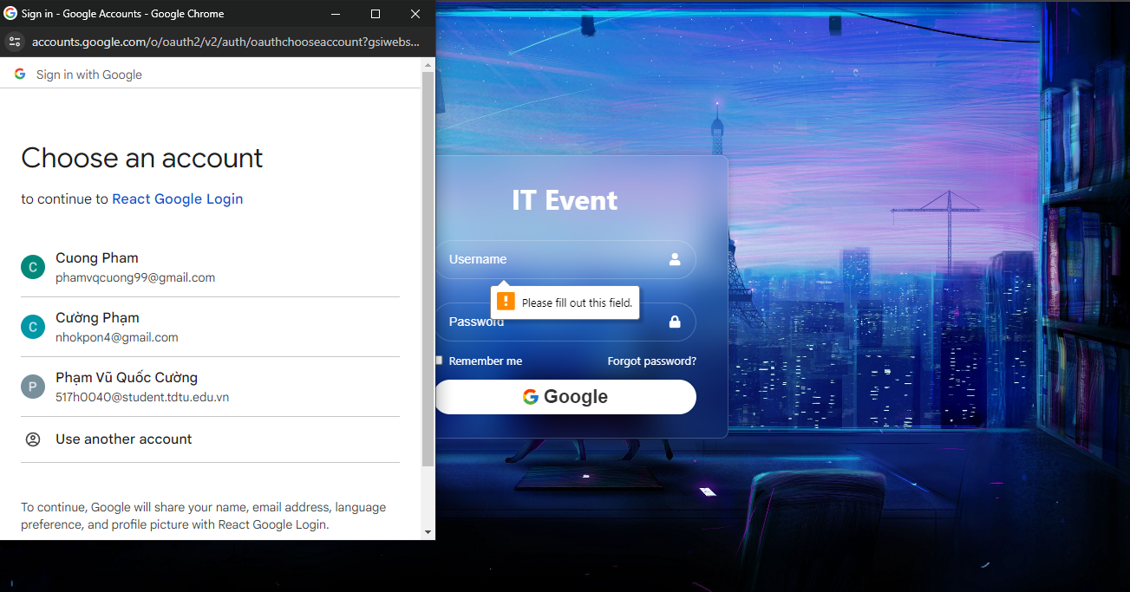
Login Page
13

Slide 14
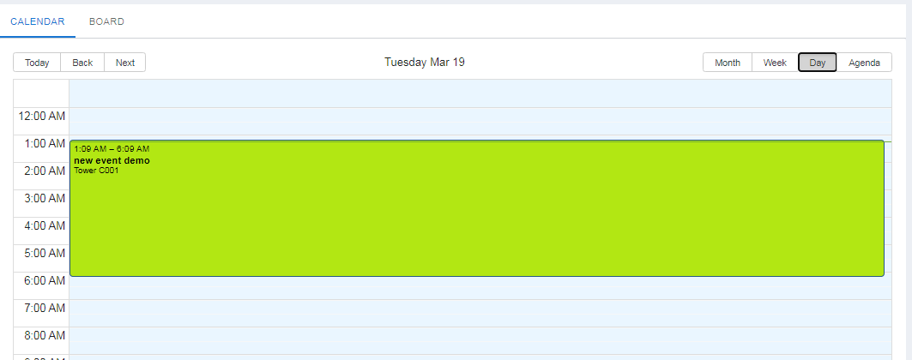
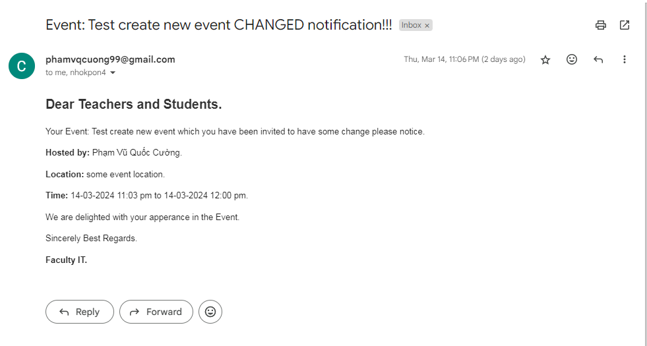
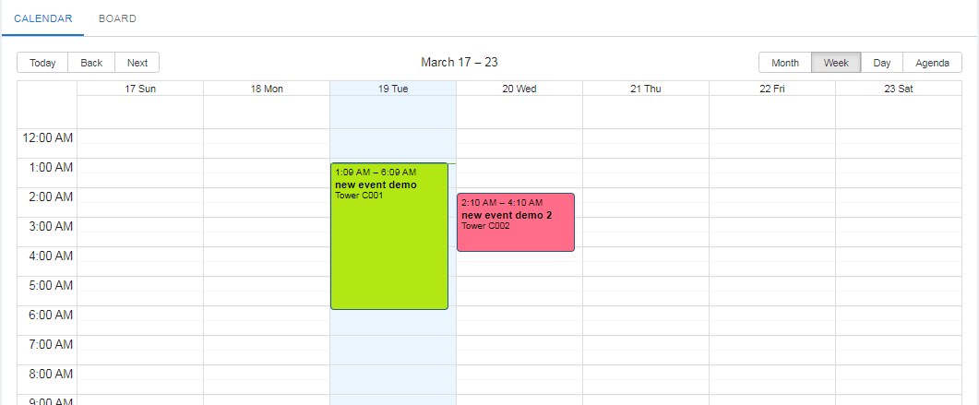
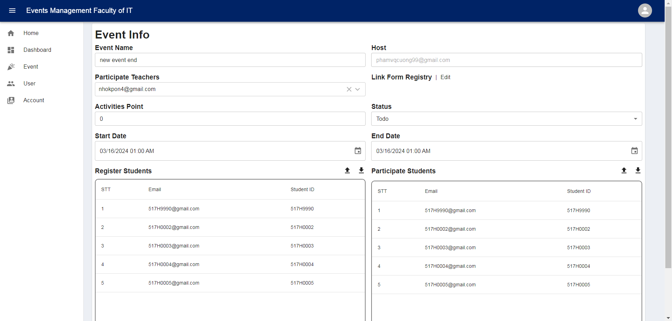
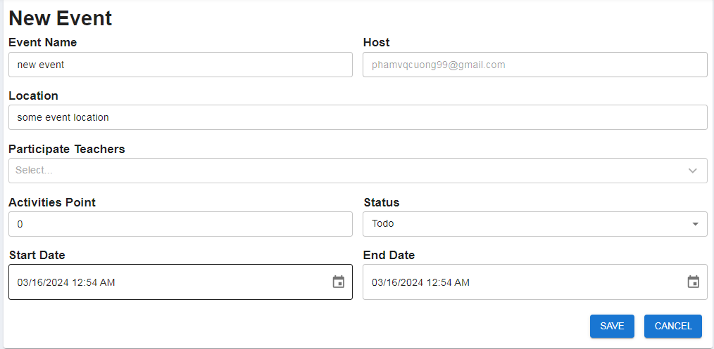
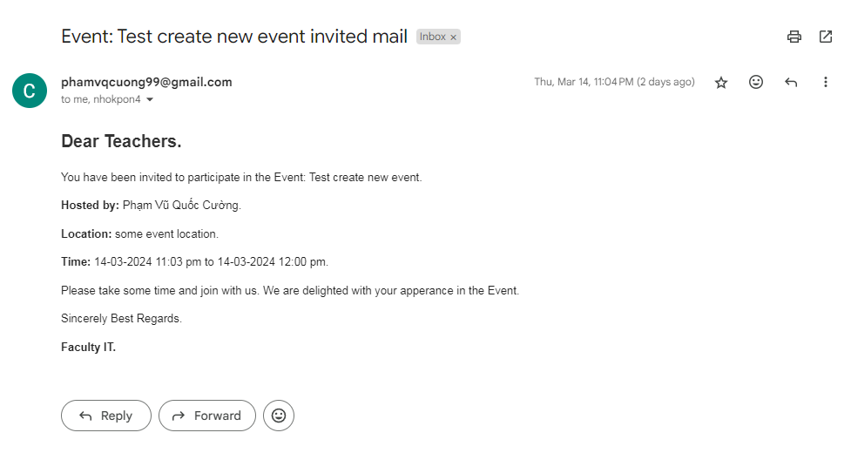
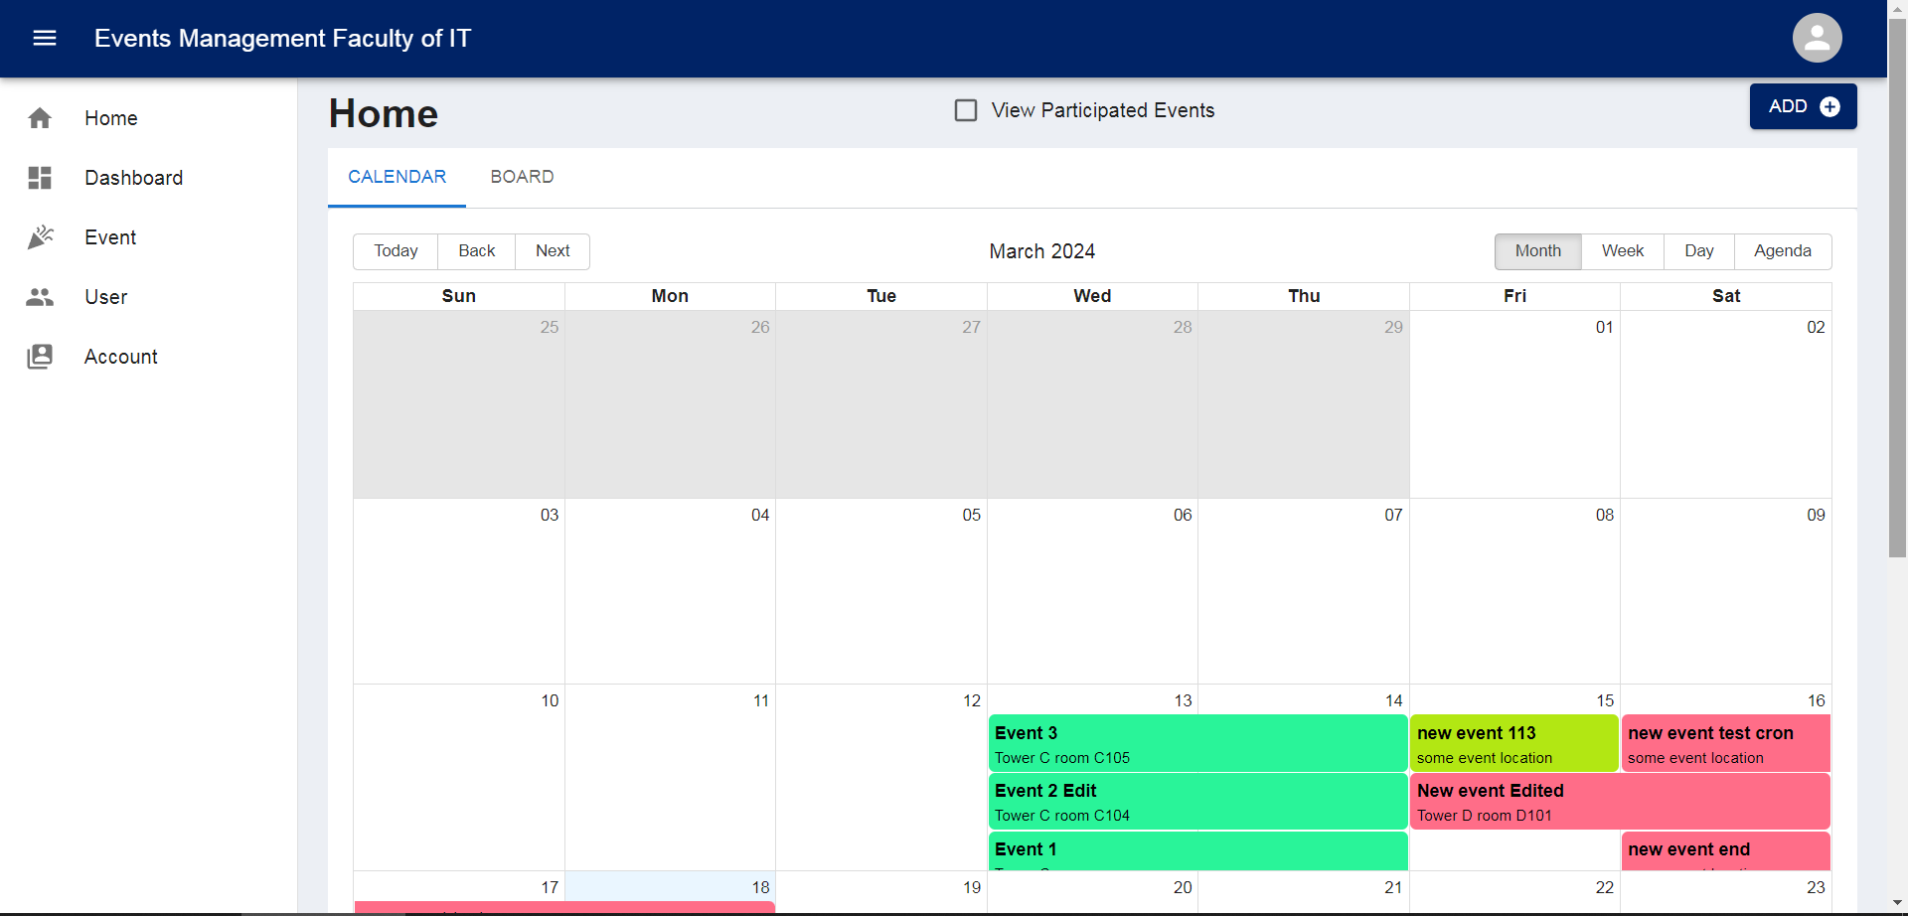
Home Calendar
14

Slide 15
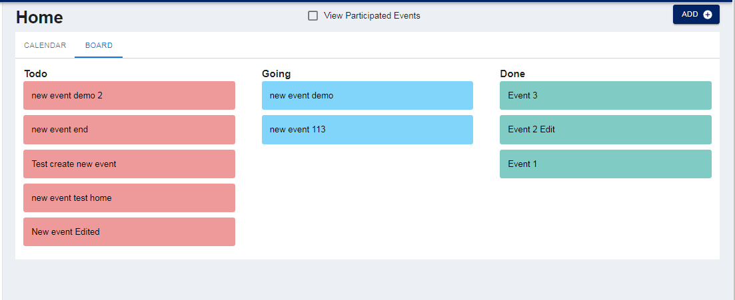
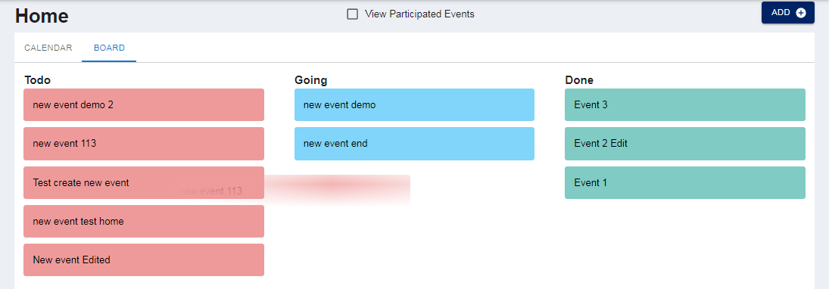
Home Board
15

Slide 16
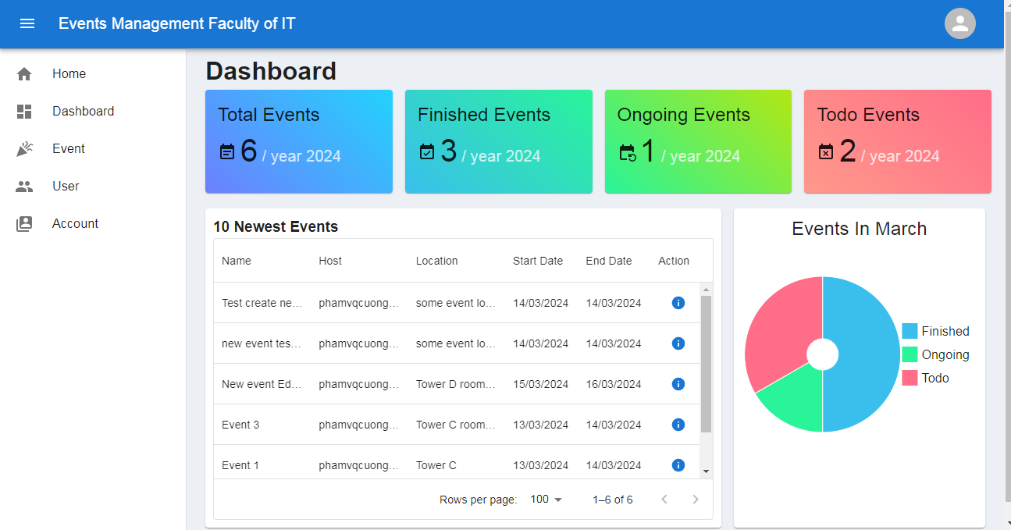
Dashboard Page
16

Slide 17
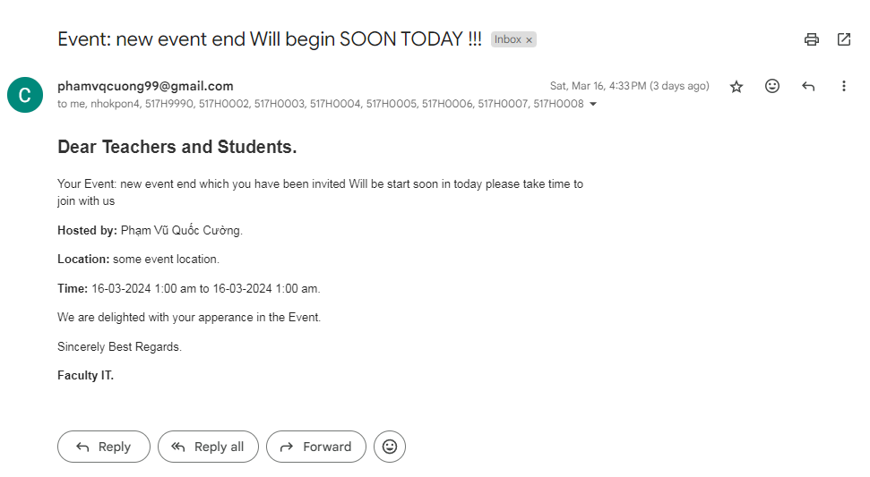
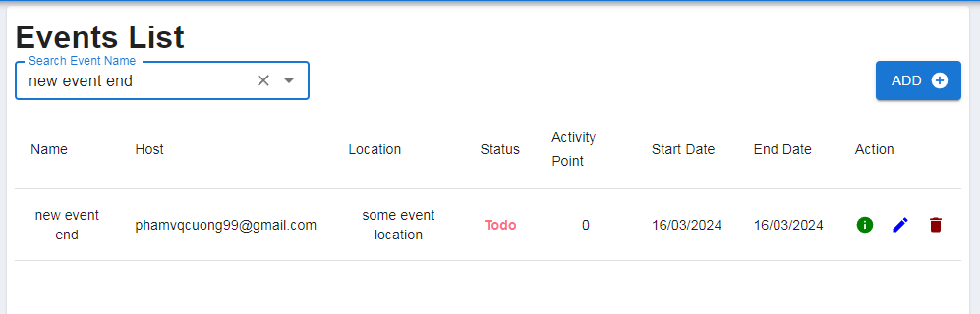
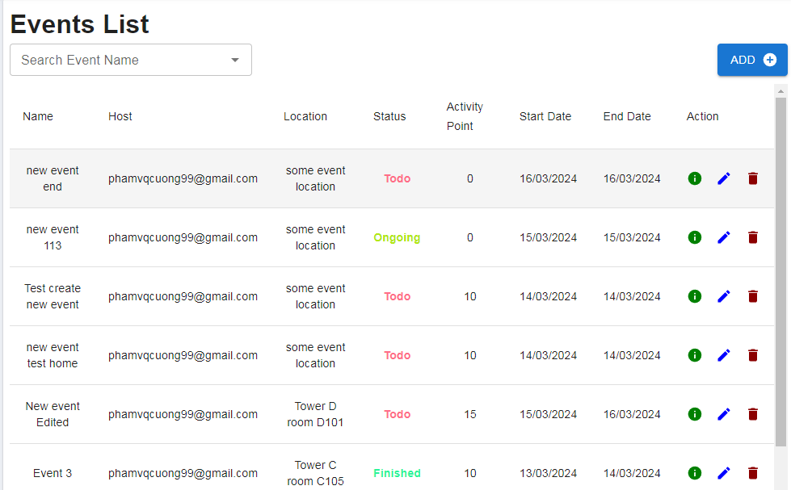
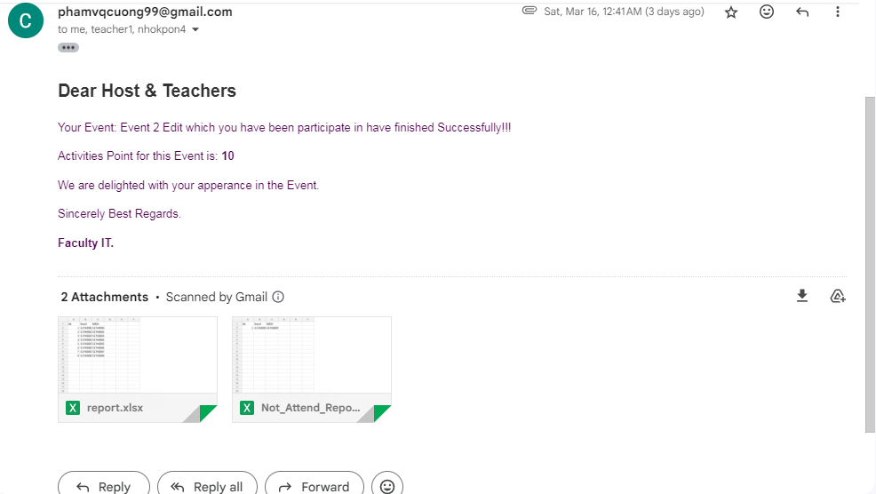
Events Page
17

Slide 18
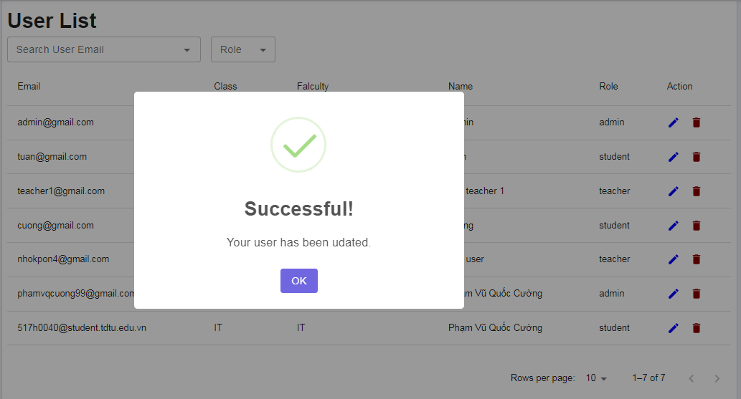
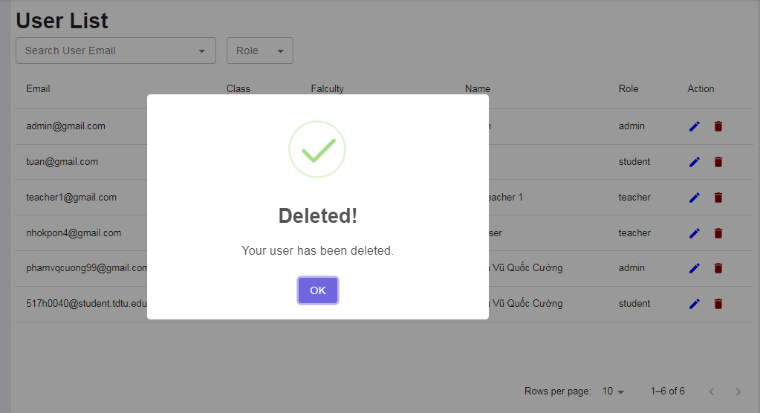
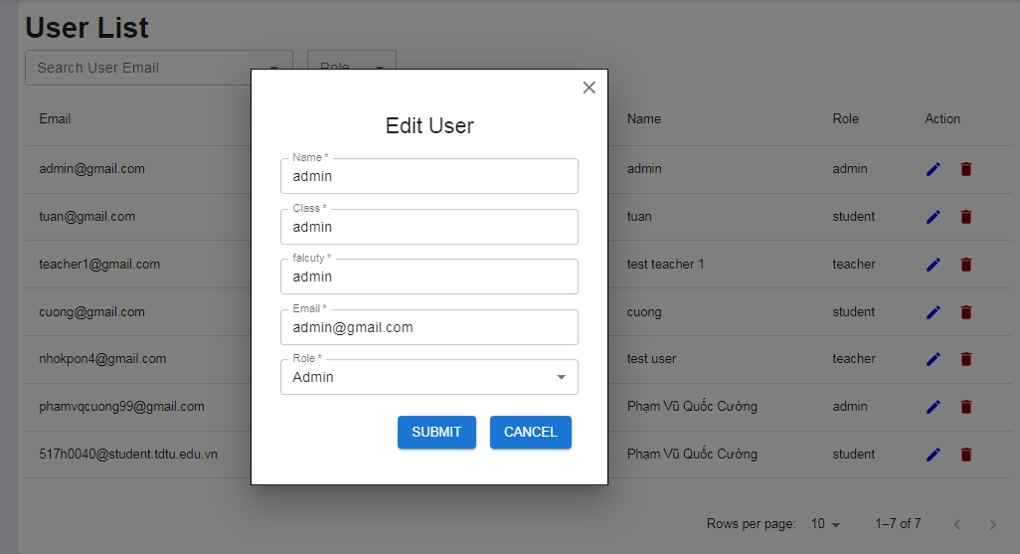
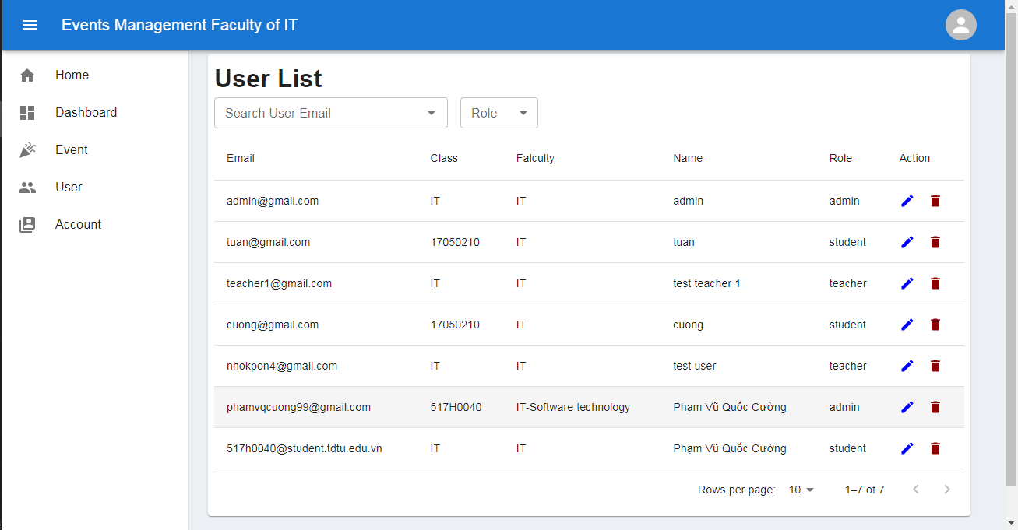
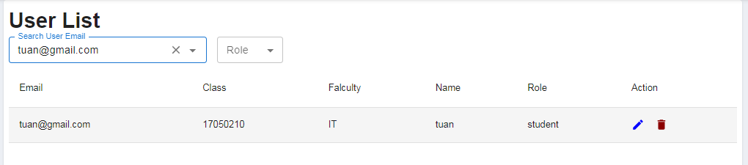
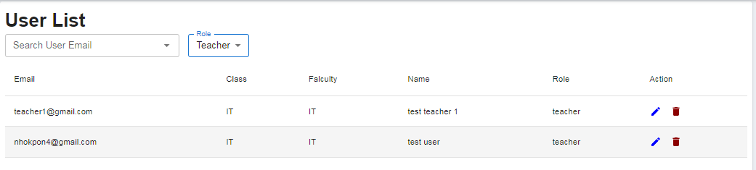
User Page
18

Slide 19
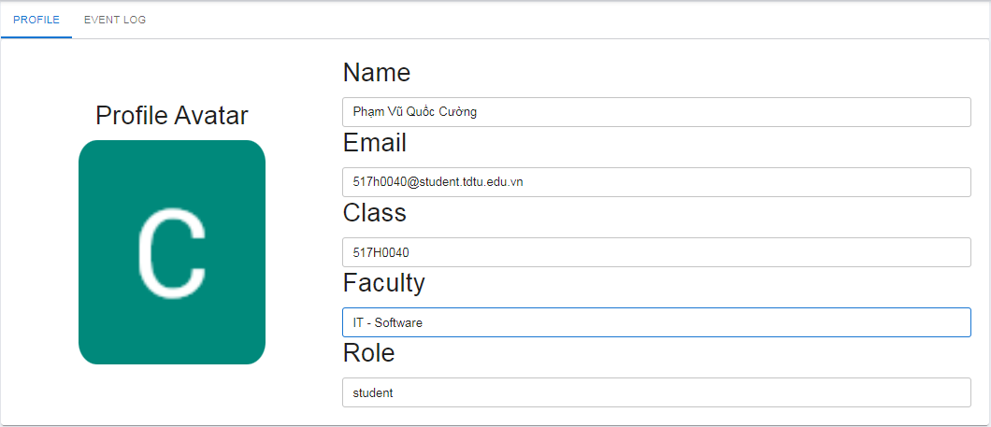
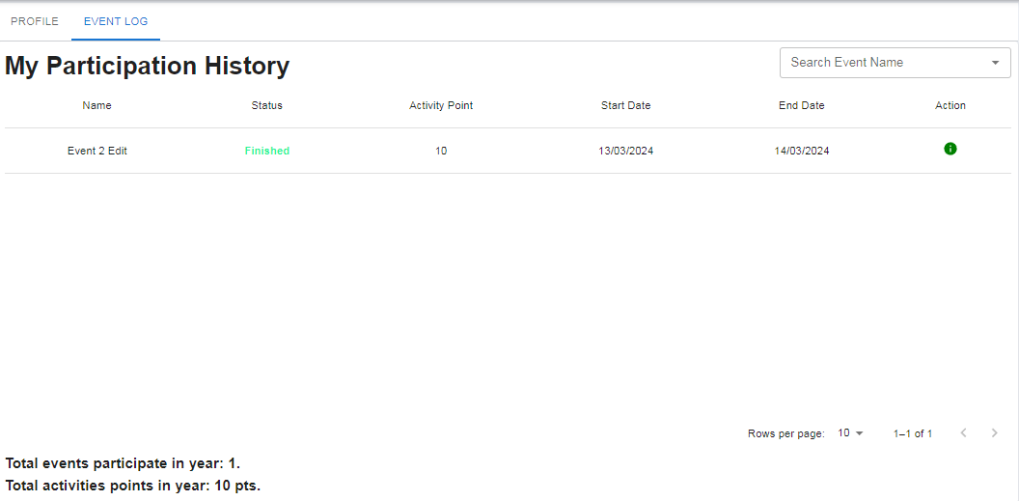
Account Page
19

Slide 20
05 Advantages, Disadvantages
Advatages
High integration capabilities. Information manage.
Noticeable effect
Intuitive interface.
Diverse and automated features.
Disadvantages
The data has not been applied in reality, so the actual performance is unknown
The ability to interact with users is not high..
Job Cron has not yet automated too many jobs.
20

Slide 21
06
Orientation and Summary
Future Directions
Expand development to manage school-wide events, develop user interaction features, add AI tools to support user interaction. Mobile application development.
Summarize
The process management website project for activities and events of the Faculty of Information Technology is a great success, bringing many benefits to the faculty.
The website has met the requirements and is effective in managing the department's events.
With the limitations and development directions set out, the website promises to continue to be improved and developed to better meet the needs of users.
21

Slide 22
07
Reference Documents
22

Slide 23
Reference Documents
The Best Guide to Know What Is React. (n.d.). Retrieved March 21, 2024, from Simplilearn.com website: https://www.simplilearn.com/tutorials/reactjs-tutorial/what-is-reactjs
Why Use MongoDB: What It Is and What Are the Benefits. (2021, March 31). Retrieved March 21, 2024, from Simplilearn.com website: https://www.simplilearn.com/tutorials/mongodb-tutorial/what-is-mongodb
23

Slide 24
08 Demo
24

Slide 25


Our team
Phạm Vũ Quốc Cường
Trần Phạm Anh Tuấn
25

Slide 26

Thanks For Watching
Do you have any questions?
517H0040@student.tdtu.edu.vn
517H0093@student.tdtu.edu.vn
26

